Slide 1
MAZE QUEST:
BFS vs DFS

Slide 2
Agenda
PROBLEM STATEMENT
PROBLEM DEFINITION
ALGORITHMS
FLOWCHART
PROGRAM
OUTPUT

Slide 3
PROBLEM STATEMENT
Implementing an AI agent that solves mazes using BFS and DFS comparing their performances.
This project aims to implement an AI agent that utilizes Breadth-First Search (BFS) and Depth-First Search (DFS) to solve mazes and compare their performances based on different criteria such as execution time, memory usage, and path optimality.
OBJECTIVES :
The primary objective is to compare their performances based on key metrics such as execution time and path optimality. By analyzing the strengths and weaknesses of each approach, this study will provide insights into their suitability for different maze structures and real-world applications.

Slide 4
PROBLEM DEFINITION
Given a 2D grid-based maze with walls, an initial starting position, and a goal position, the AI agent must:
Implement BFS and DFS to traverse the maze and find a valid path (if one exists).
Compare the two algorithms based on:
Path length (optimal vs. non-optimal solutions)
Number of nodes explored (efficiency of search)
Execution time (computational performance)
Analyze how maze size and structure (density of walls, branching factor) impact the performance of both algorithms.

Slide 5
BFS ALGORITHM
How BFS Works?
Initialize: Start at the source node and mark it as visited.
Use a Queue: Push the starting node into a queue (FIFO structure).
Expand Nodes: Dequeue a node, process it, and enqueue all its unvisited neighbors.
Repeat Until Done: Continue until all reachable nodes are visited.

Slide 6
DFS ALGORITHM
How DFS Works?
Start at a node (source).
Mark it as visited.
Visit an adjacent unvisited node, mark it as visited, and repeat (go deeper).
If a node has no unvisited neighbors, backtrack to the previous node.
Continue until all reachable nodes are visited.

Slide 7
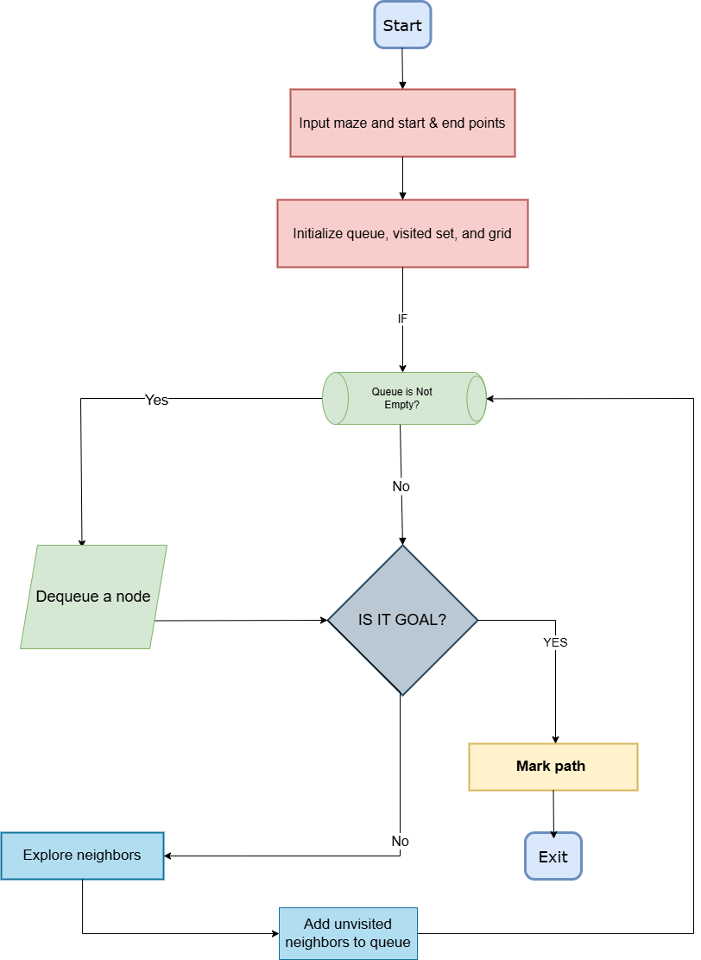
BFS FLOWCHART

Slide 8
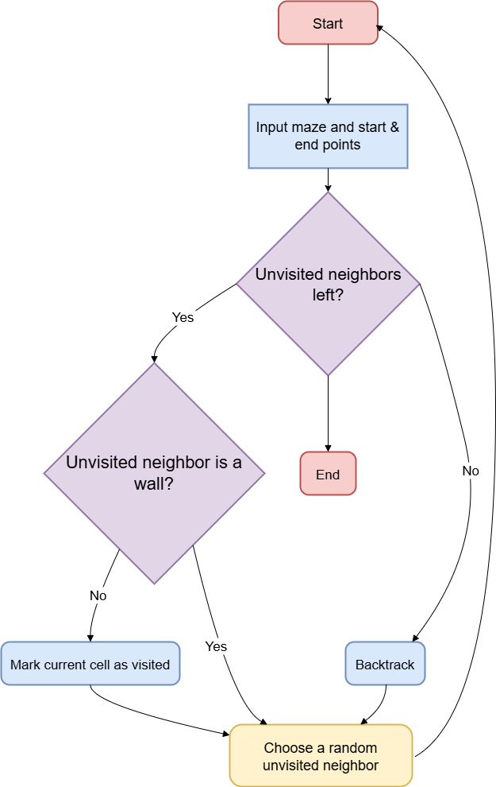
DFS FLOWCHART

Slide 9
Libraries
PYMAZE
The “pymaze” library in Python is a simple, easy-to-use library designed for generating and solving mazes. It allows you to create random mazes and you can specify their size, complexity and algorithm used to generate the maze. Additionally, it provides tools to visualize and solve mazes using algorithms like BFS and DFS.
TIMEIT
The “timeit” library in Python is used to measure the execution time of small code snippets. It provides an accurate way to time code execution by reducing the impact of other processes running on the system.

Slide 10
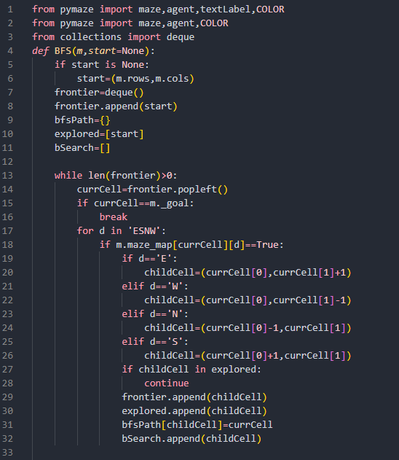
BFS Code

Slide 11
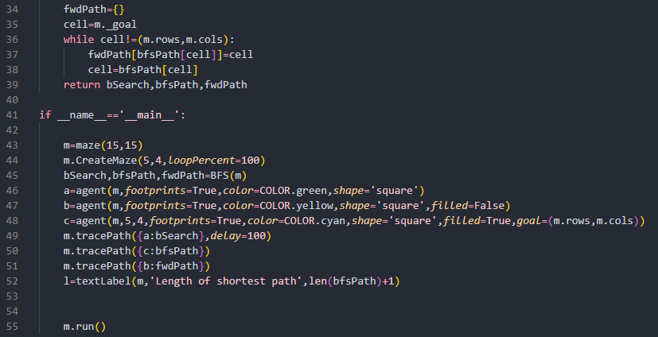
BFS Code

Slide 12
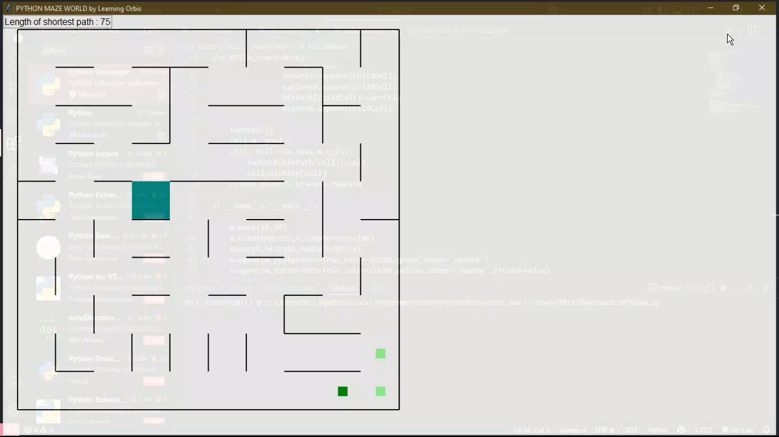
BFS Output

Slide 13
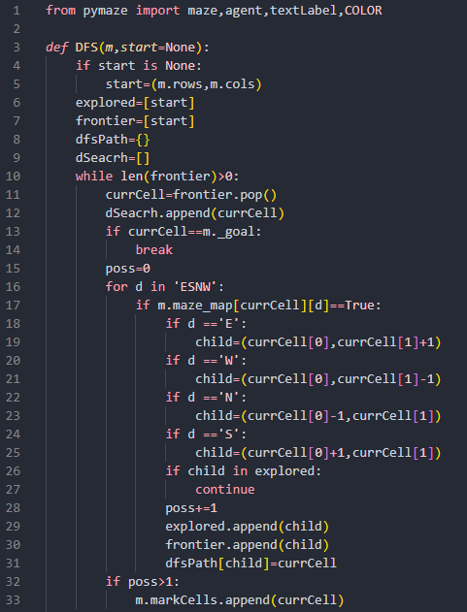
DFS Code

Slide 14
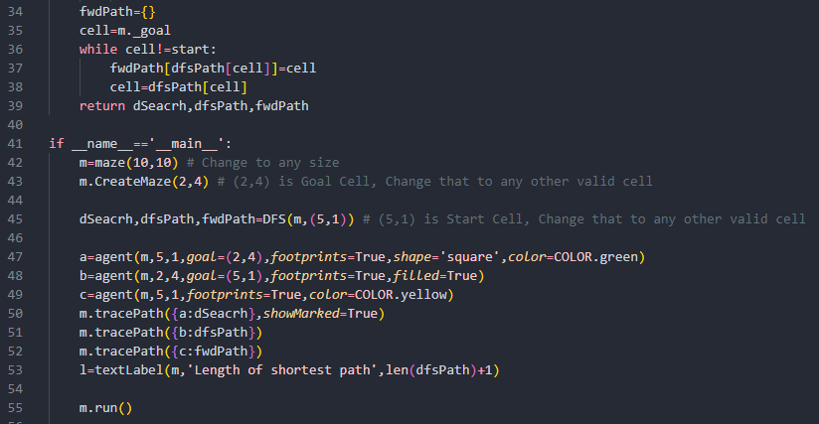
DFS Code

Slide 15
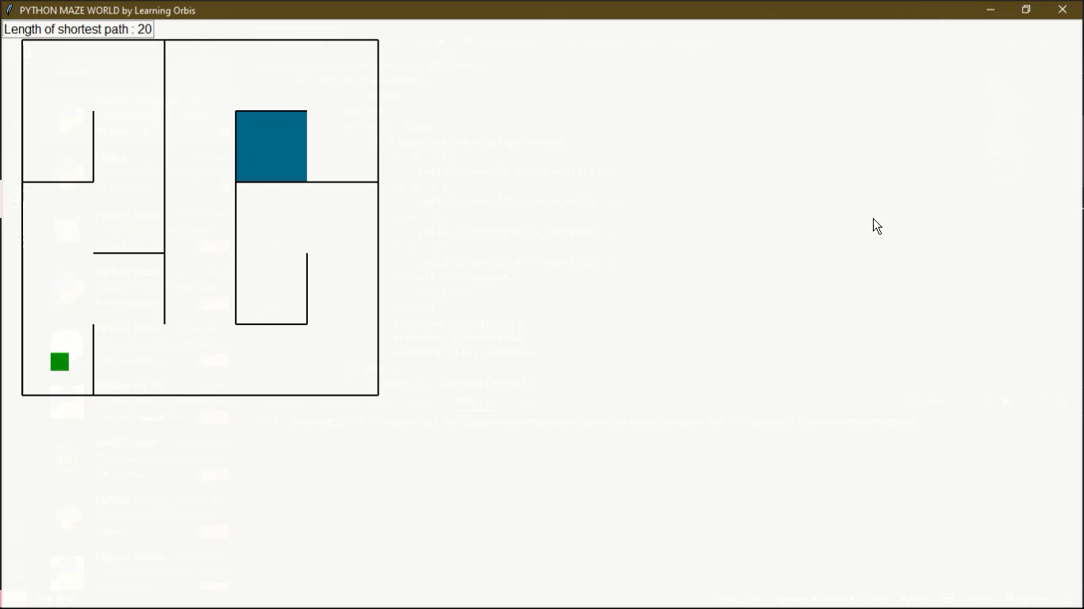
DFS Output

Slide 16
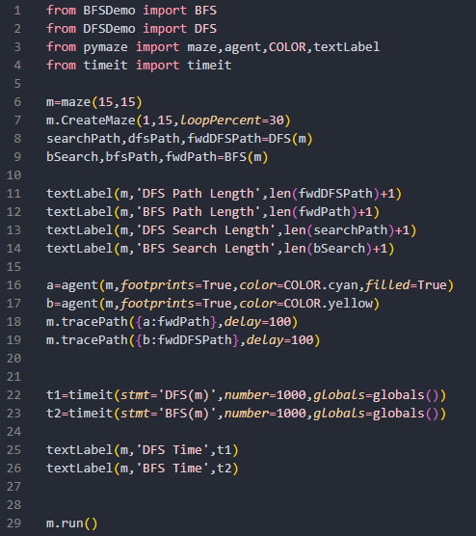
BFS vs DFS

Slide 17
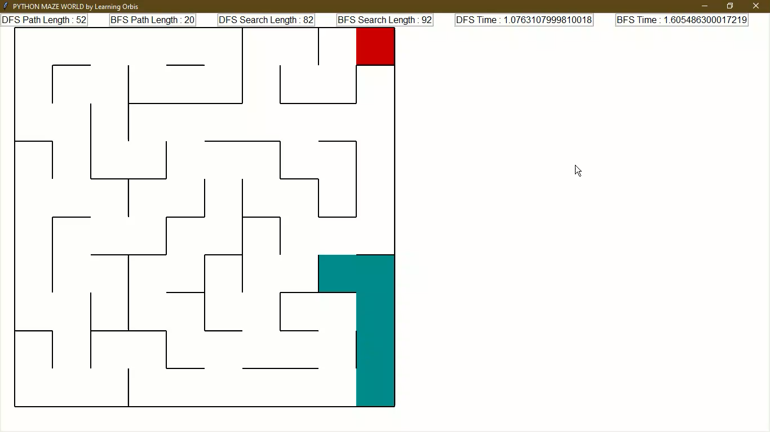
FINAL OUTPUT

Slide 18
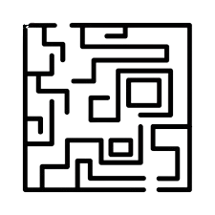
THANK
YOU !!
Presented By : Khushi Pardhi [AIDSU23010]
Madhura Nilawar [AIDSU23012]
Saloni Chavhan [AIDSU23015]
Vedika Welukar [AIDSU23027]
Anjali Sune [AIDSU23D070]

